Slide 1
CDE COHORT – 2 PROJECT
JOSEPH ITOPA ABUBAKAR

Slide 2
Design Background
Coretelecoms is a company based in US, and they operate in the Telecom space. The company's challenge rest in the area of customer retention, which is critical to the business. Customers have series of challenges which the company collates through several channels:
social media complaints

Slide 3
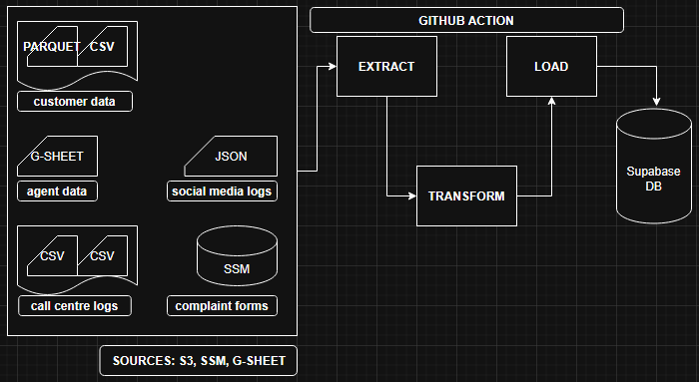
SYSTEM ARCHITECTURE

Slide 4
Choice of tools and technology
Python
SQL
AWS, GCP
Github Action
Supabase

Slide 5
PROCESSES
SOURCES: There are several sources, and the data extraction phases handle the pulling of the data from those sources:
  Customers: s3
  Agents: Googlesheet
  Call Center Logs: s3
  Social Media: s3
  Website Complaint Form: Database Application
Each source is pulled in, and store in temporary folder for transformation.

Slide 6
PROCESSES
TRANSFORMATION: While there are general transformation, some transformation are specific to the source. :
  Customers: column inconsistency and wrong date format.
  Agents: okay
  Call Center Logs: column names were highly inconsistent. Fixed and combined.
  Social Media: column inconsistency and wrong date format.
  Website Complaint Form: column inconsistency and wrong date format.

Slide 7
PROCESSES
LOAD:
  Supabase was initialized.
  The function to load the dataframe and ingest into Supabase was invoked.
  Ingestion has a chunk size of 500.
  The CSVs are compressed and loaded into s3.

Slide 8
ORCHESTRATION
The entire process is orchestrated using Github Action.
best practices:
  Idempotency
  Implementing retries.
  Failure notification/alert:- email

